Slide 1
Low-Carbon Electricity Generation: A Comprehensive Analysis
A.Y. 2022/2023
Valerio Rocca, Giacomo Virginio

Slide 2
Table of contents
01
02
03
Pre-processing and EDA
Descriptive Analyses
Data Modeling

Slide 3
01
Pre-processing and EDA

Slide 4
11
Number of datasets merged to obtain the final one

Slide 5
The datasets
Energy dataset
Other datasets
Dataset containing the main features (e.g., electricity generation from X source, net electricity import).
Contains a row for each country and for each year.
Datasets containing additional features useful for the analyses (e.g., death rate from air pollution, oil reserves).
Those datasets have been left joined to the Energy dataset.

Slide 6
The final dataset
16, 338
47
Number of rows
Variables

Slide 7
02
Descriptive Analyses

Slide 8
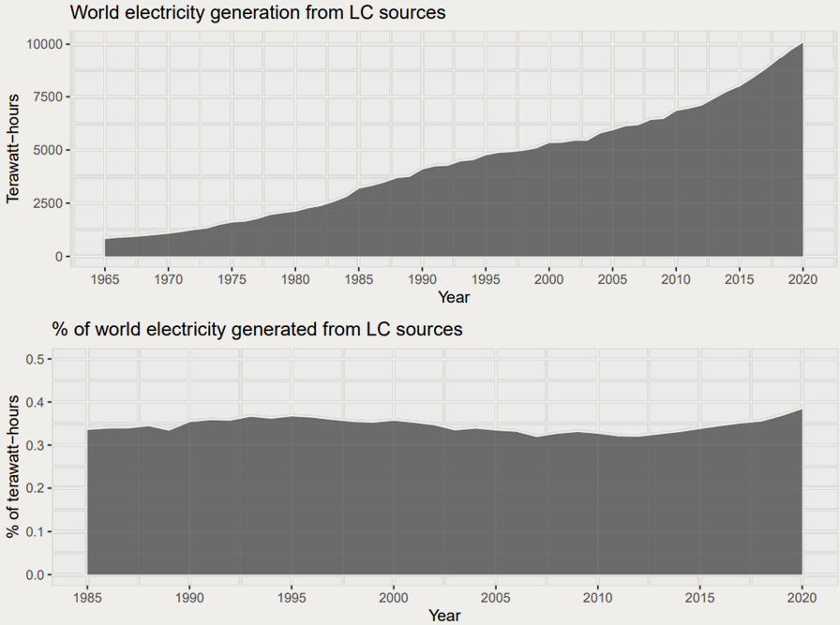
A global overview
Average yearly growth of electricity generation from LC source: 21.6%

Slide 9
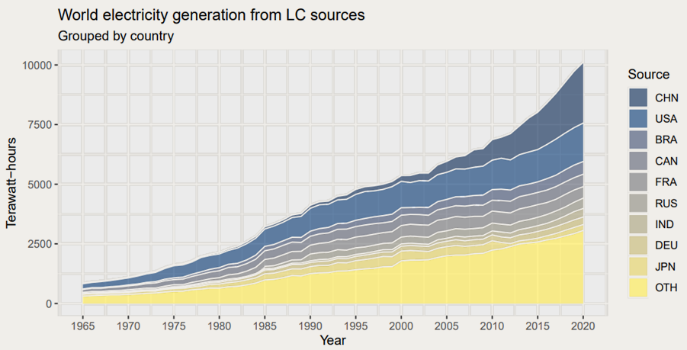
A global overview
Share of LC electricity generated by China and USA: 41%

Slide 10
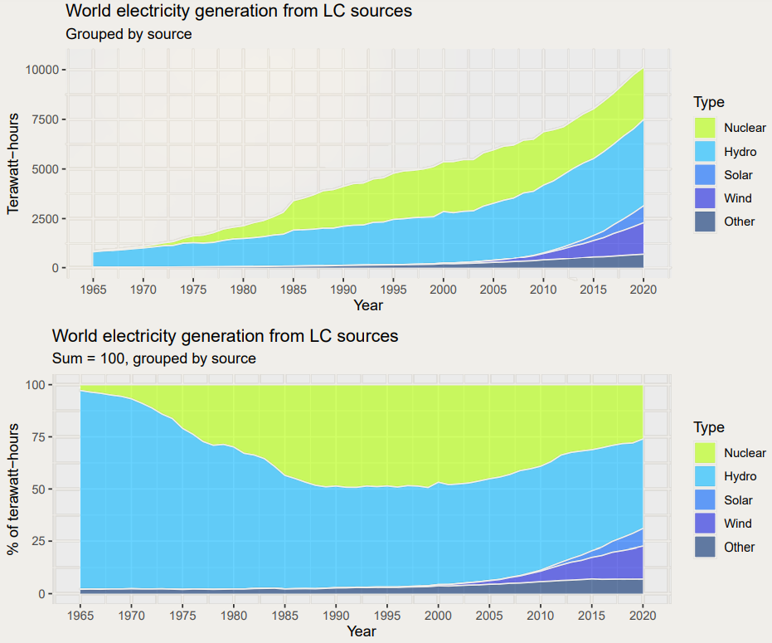
History of low-carbon generation

Slide 11
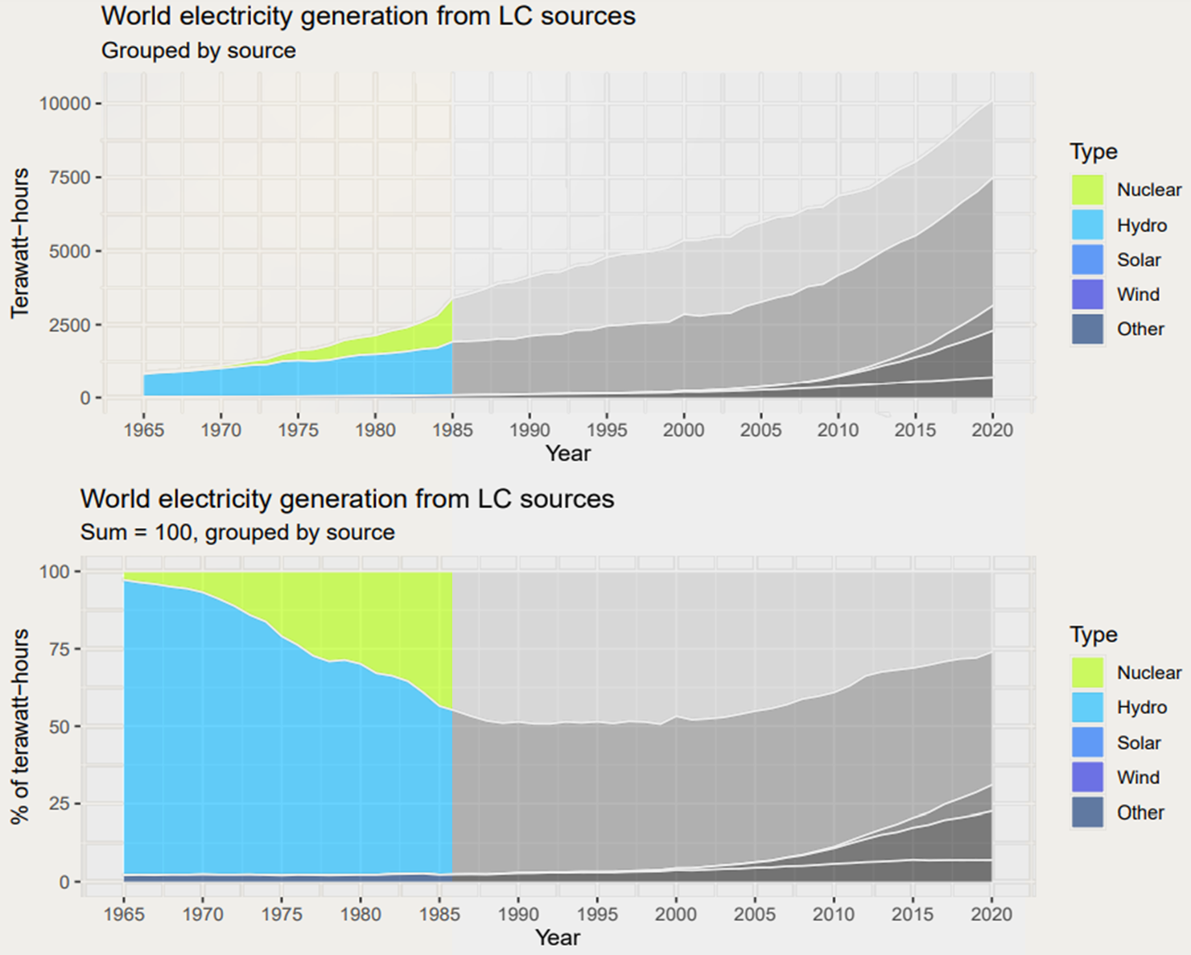
First phase: the dawn of low-carbon electricity

Slide 12
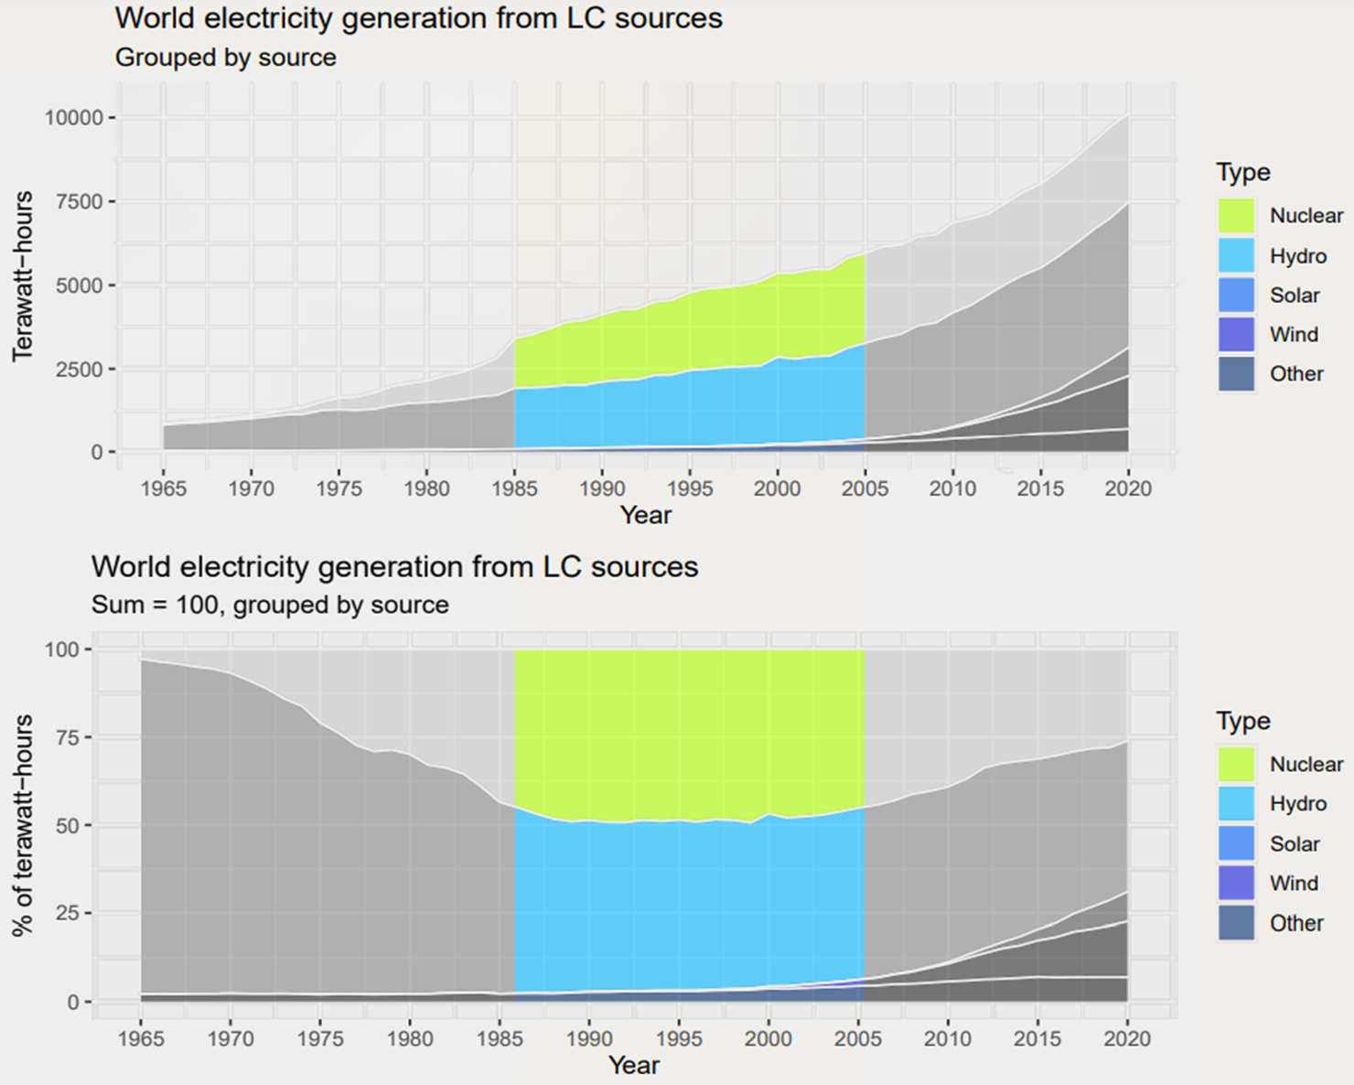
Second phase: nuclear’s golden age

Slide 13
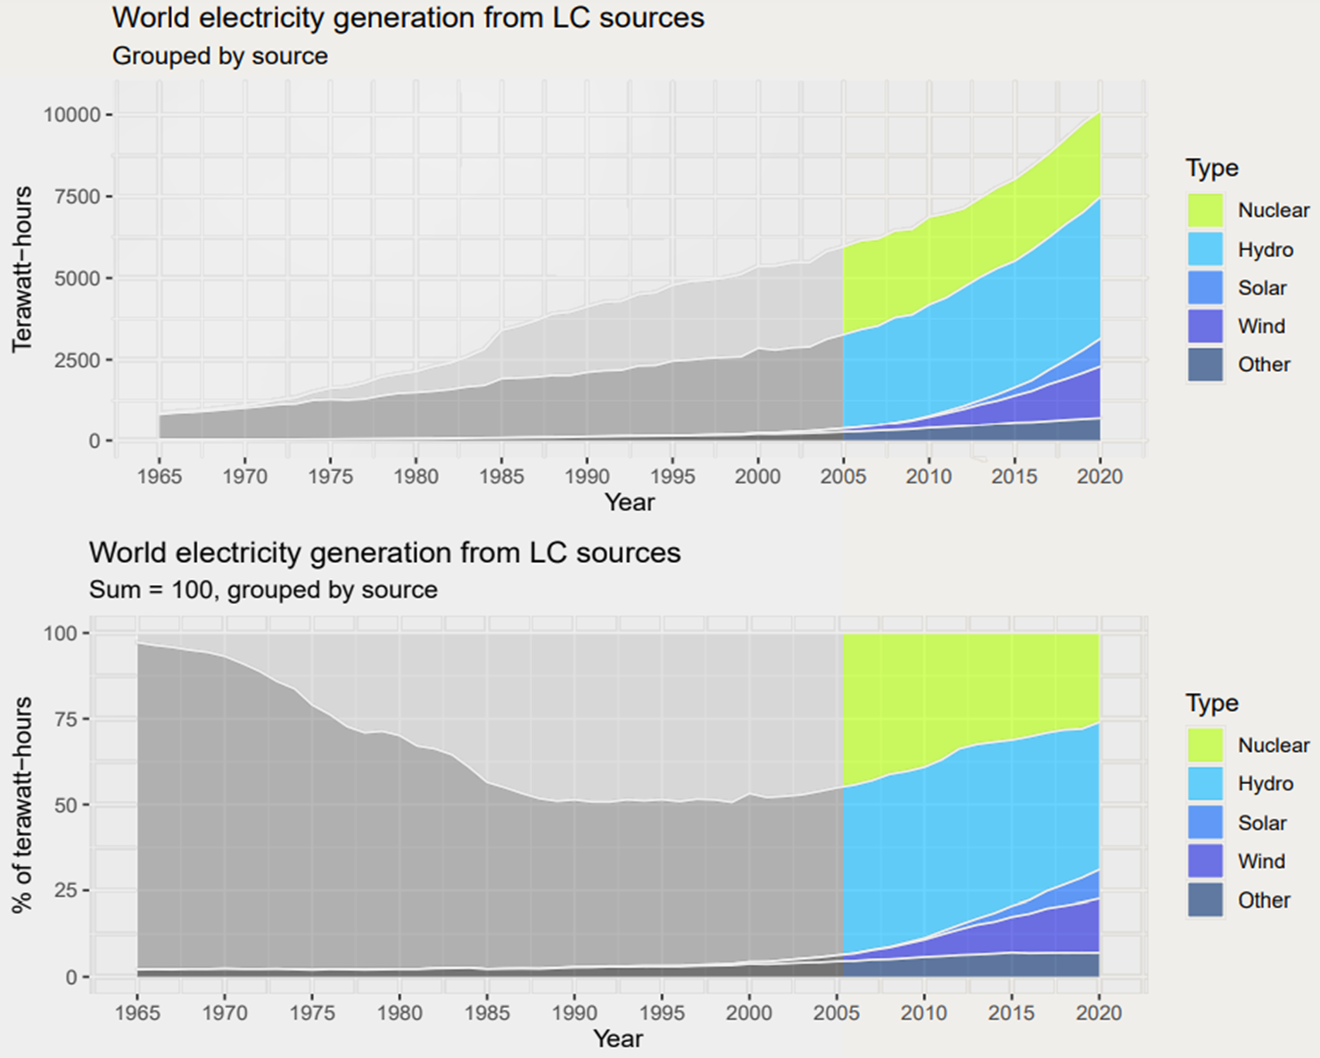
Third phase: renewables’ golden age

Slide 14
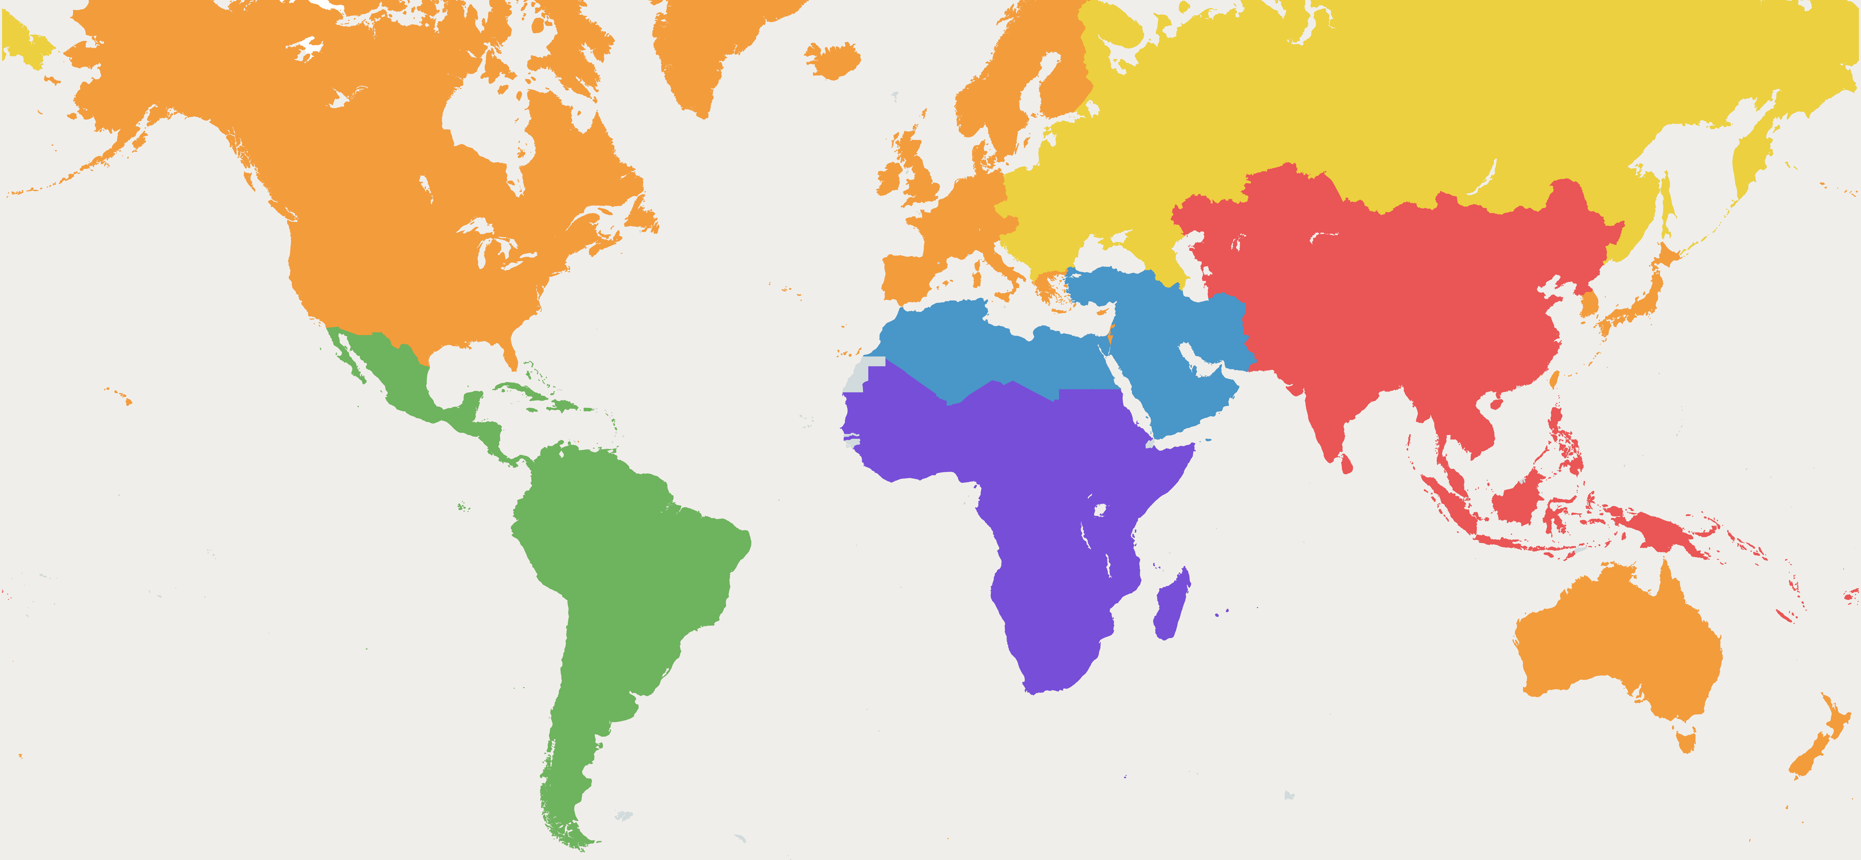
Grouping in macroregions

Slide 15
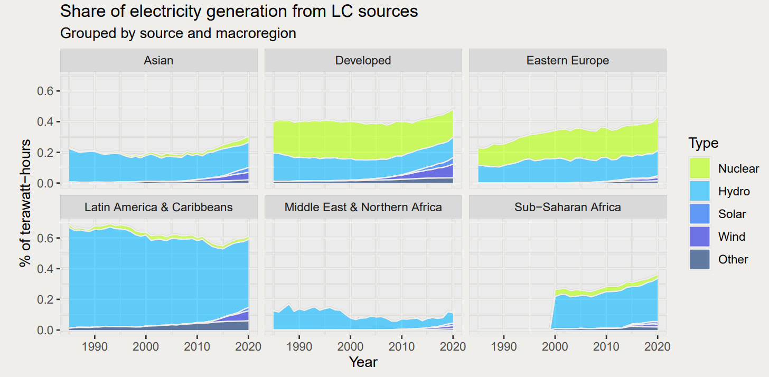
Low-carbon and macroregions: how does generation vary?

Slide 16
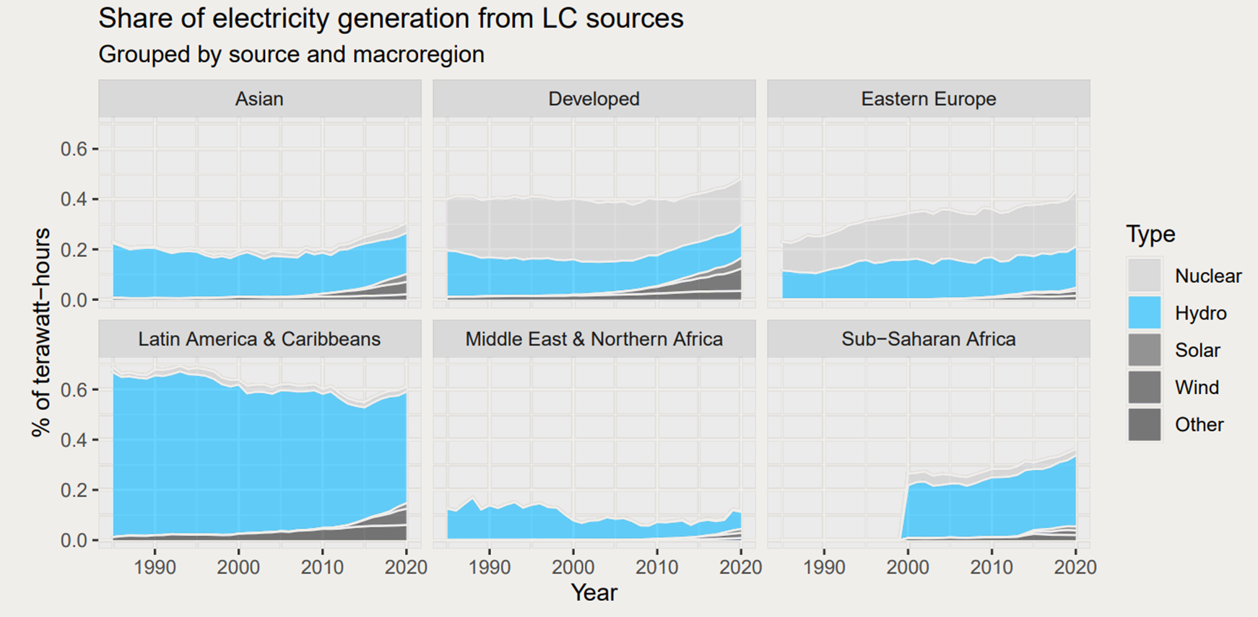
Transversal importance of hydropower

Slide 17
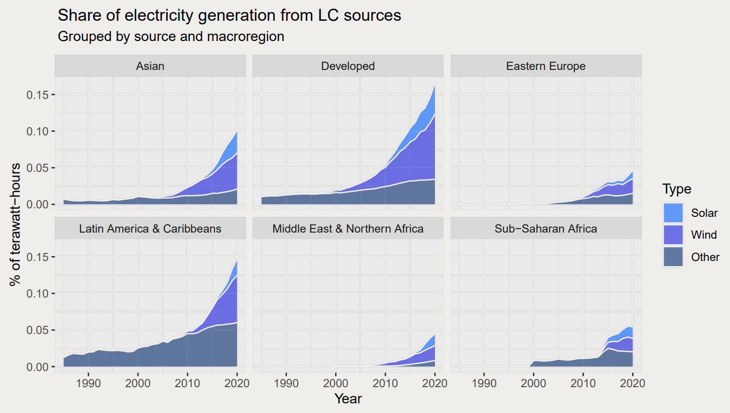
Zoom on non-hydro renewables

Slide 18
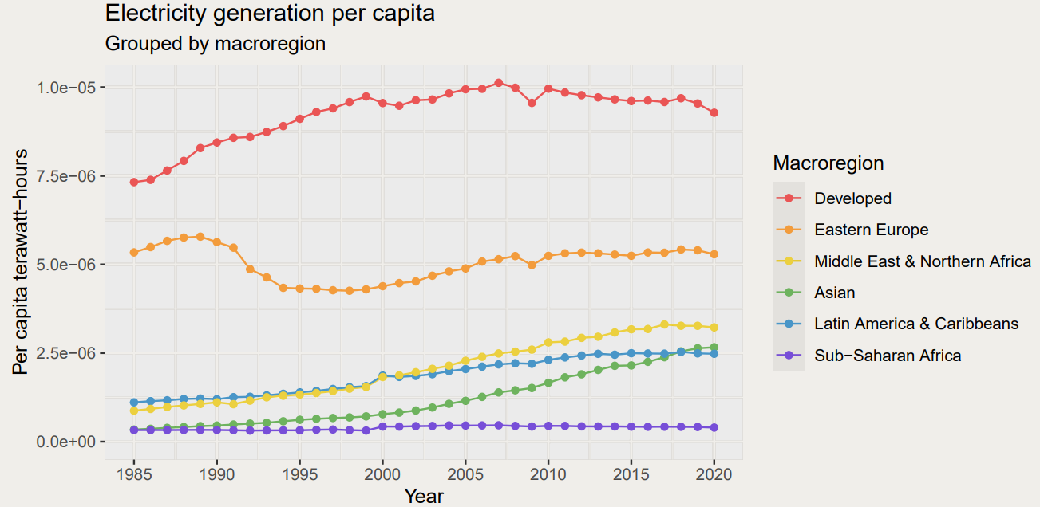
Higher share means stronger green transition?

Slide 19
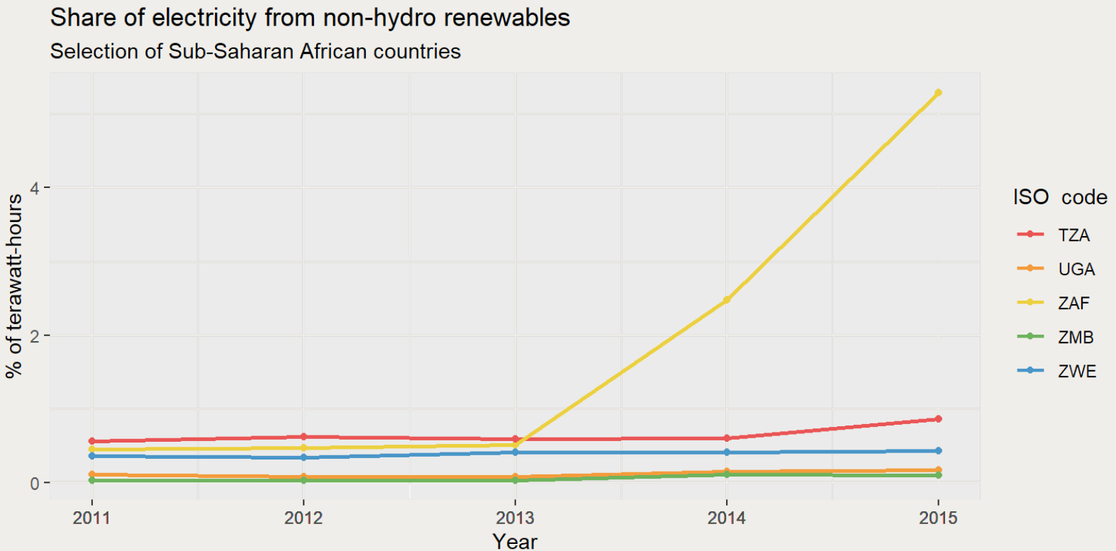
South-Africa: the outperforming country

Slide 20
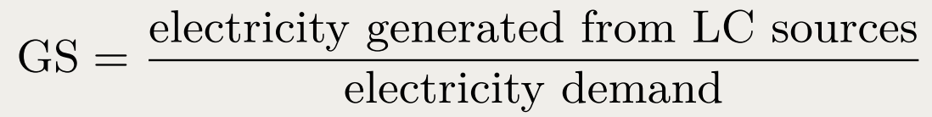
The Green Score

Slide 21
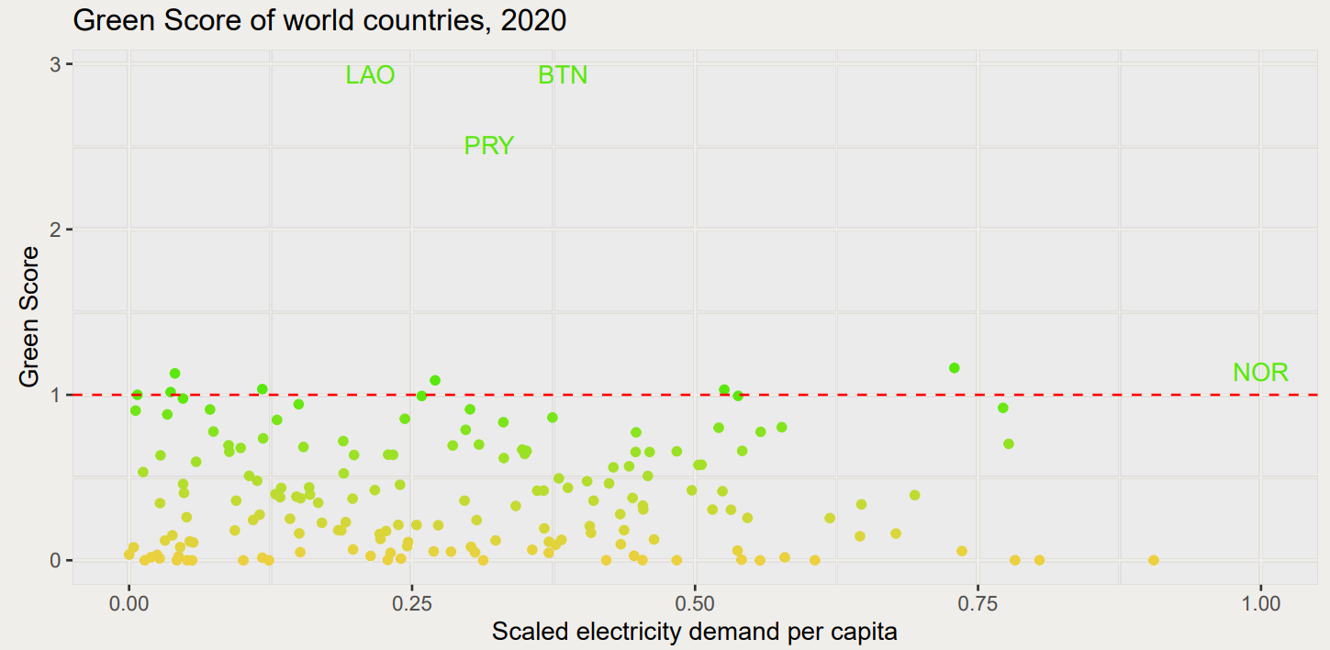
Green Score in different countries
Outliers highlighted: Laos, Bhutan, Paraguay and Norway

Slide 22
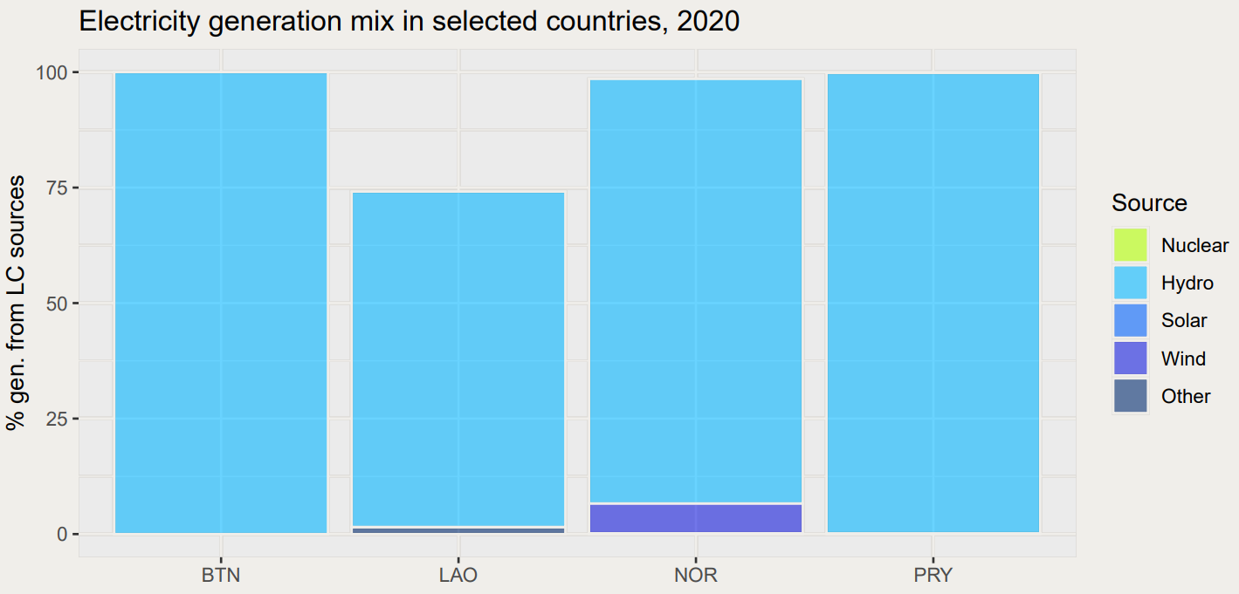
Hydropower dominance in the outliers

Slide 23
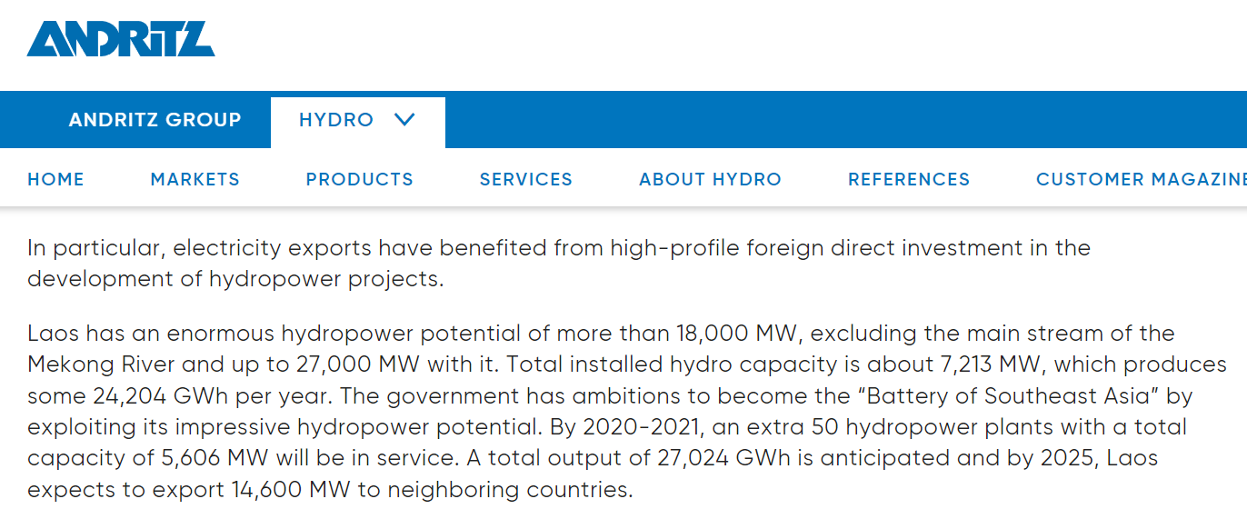
Laos: the Battery of Southeast Asia
https://www.andritz.com/hydro-en/hydronews/hydro-news-asia/laos

Slide 24
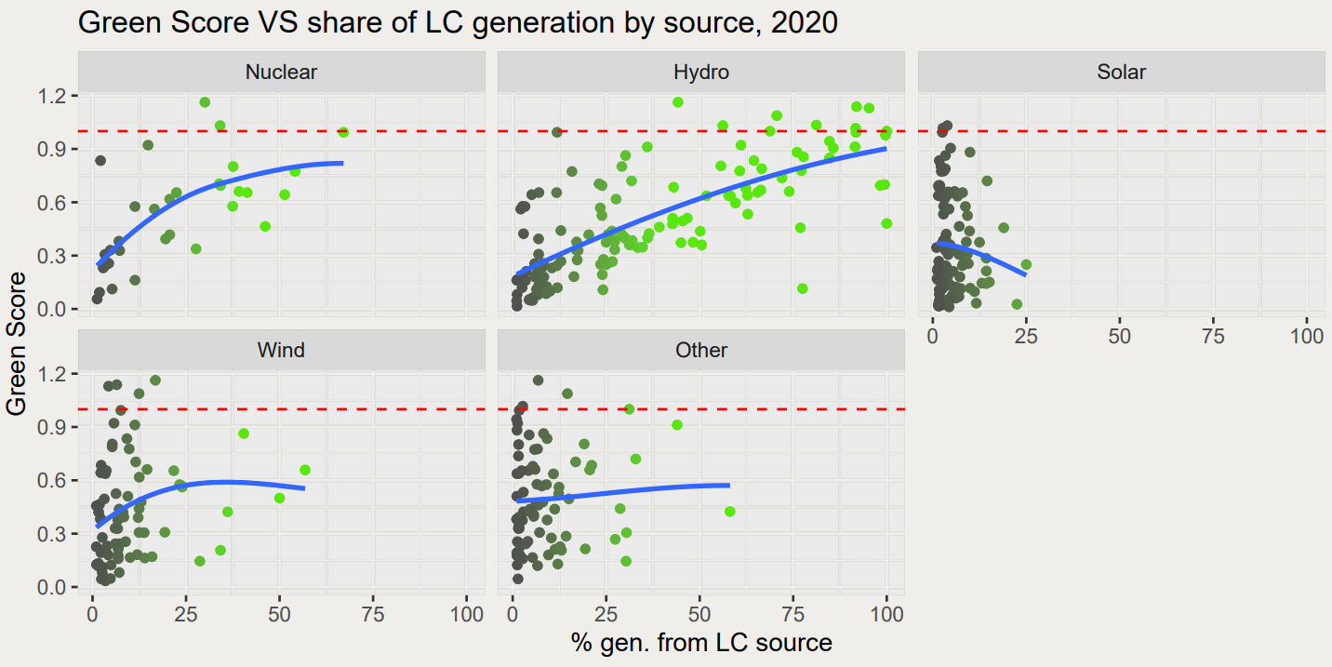
Which sources influence the Green Score?

Slide 25
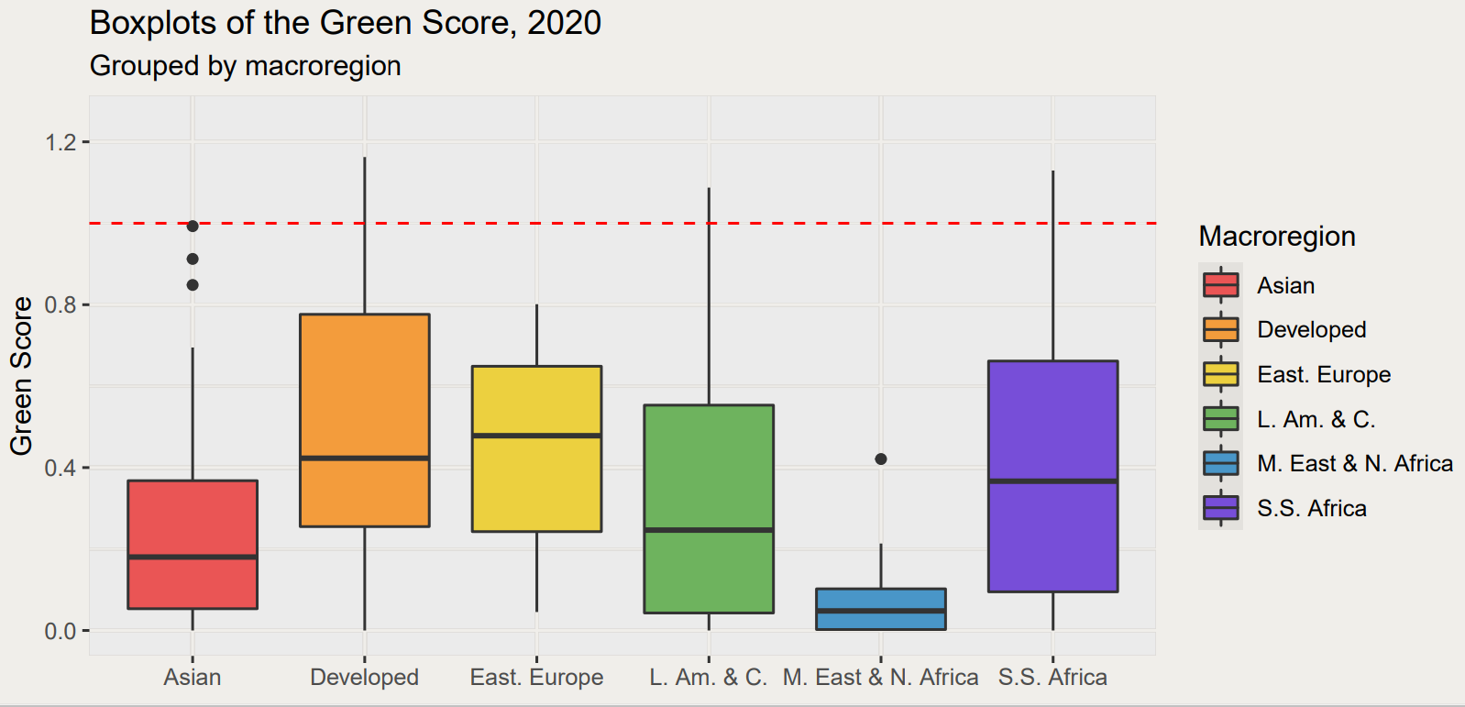
Macroregions and Green Scores

Slide 26
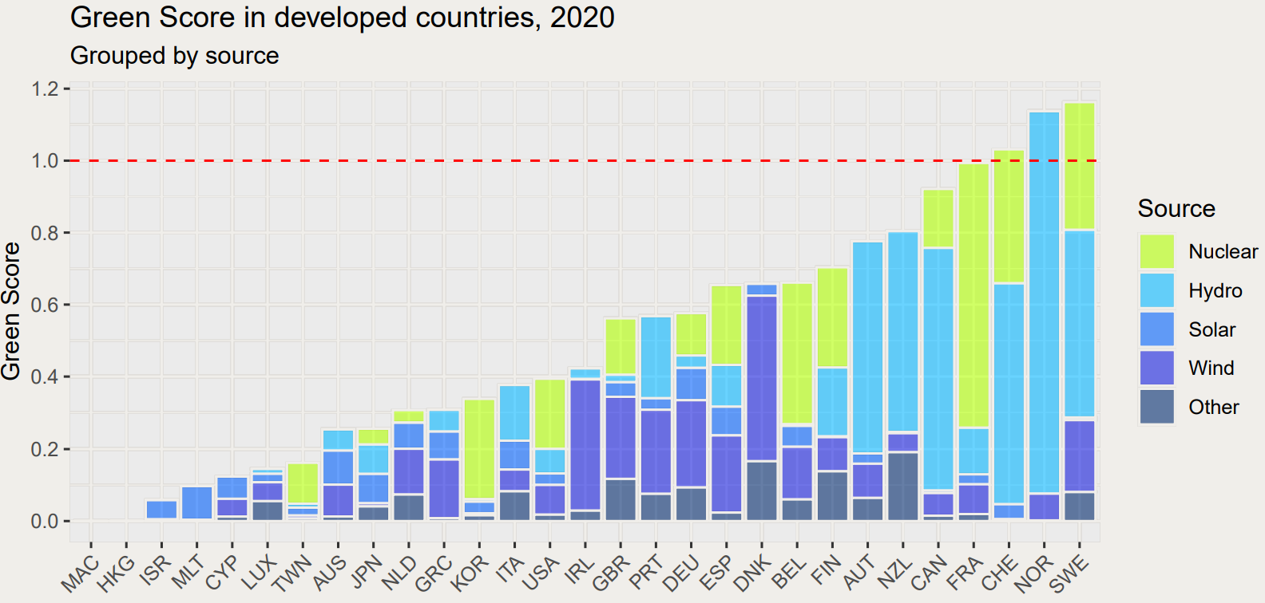
Developed Countries: an heterogeneous energy mix

Slide 27
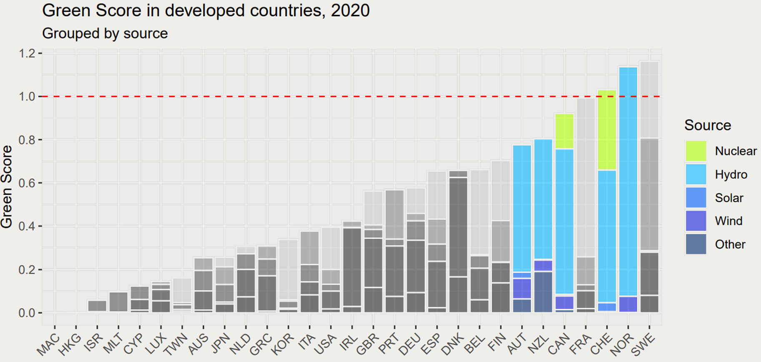
Developed Countries: some driven by hydropower

Slide 28
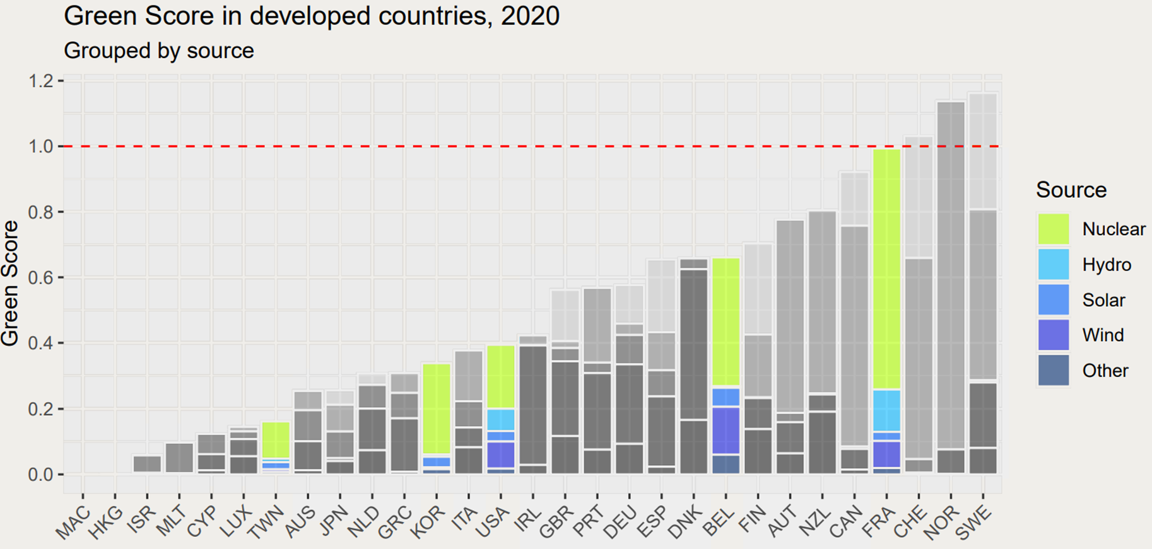
Developed Countries: others by nuclear power

Slide 29
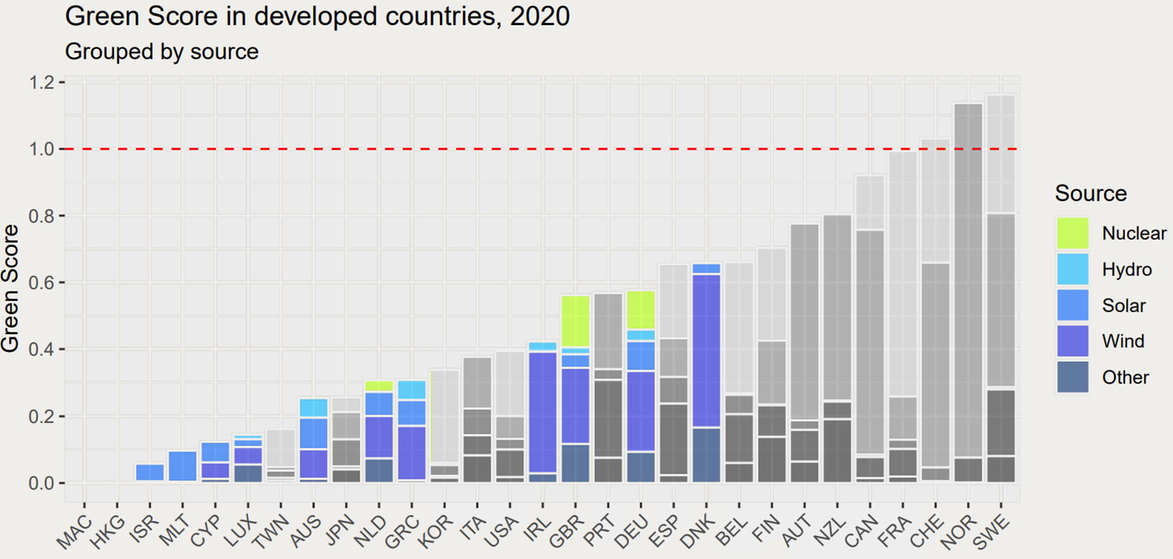
Developed Countries: others still by non-hydro renewables

Slide 30
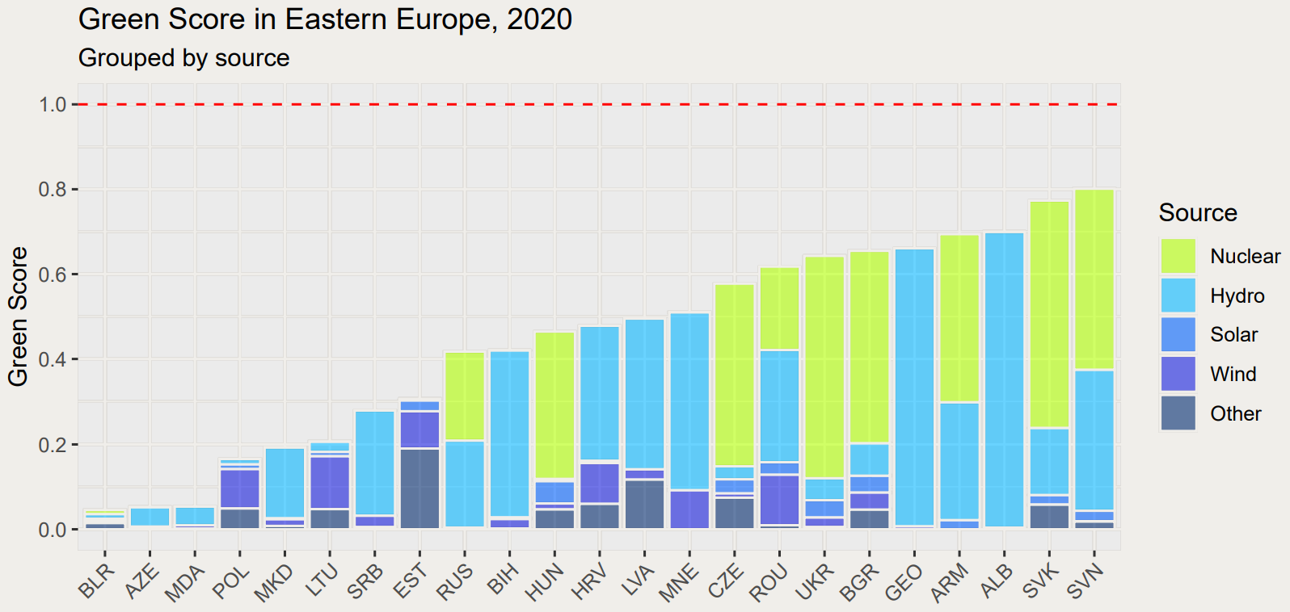
Eastern Europe: the nuclear region

Slide 31
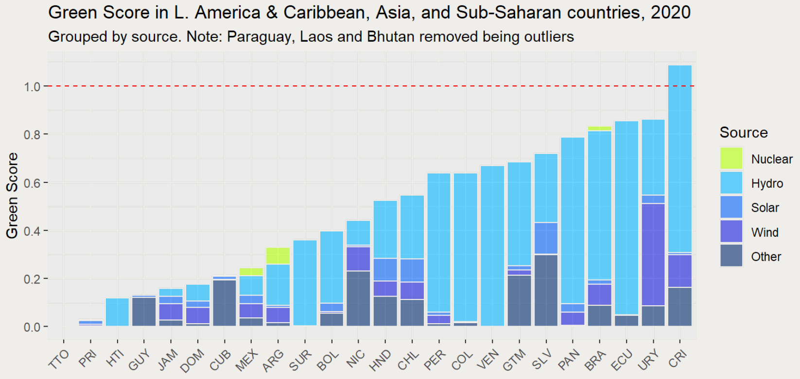
Latin-America, Asia and Sub-Saharan Africa: the hydropower rule

Slide 32
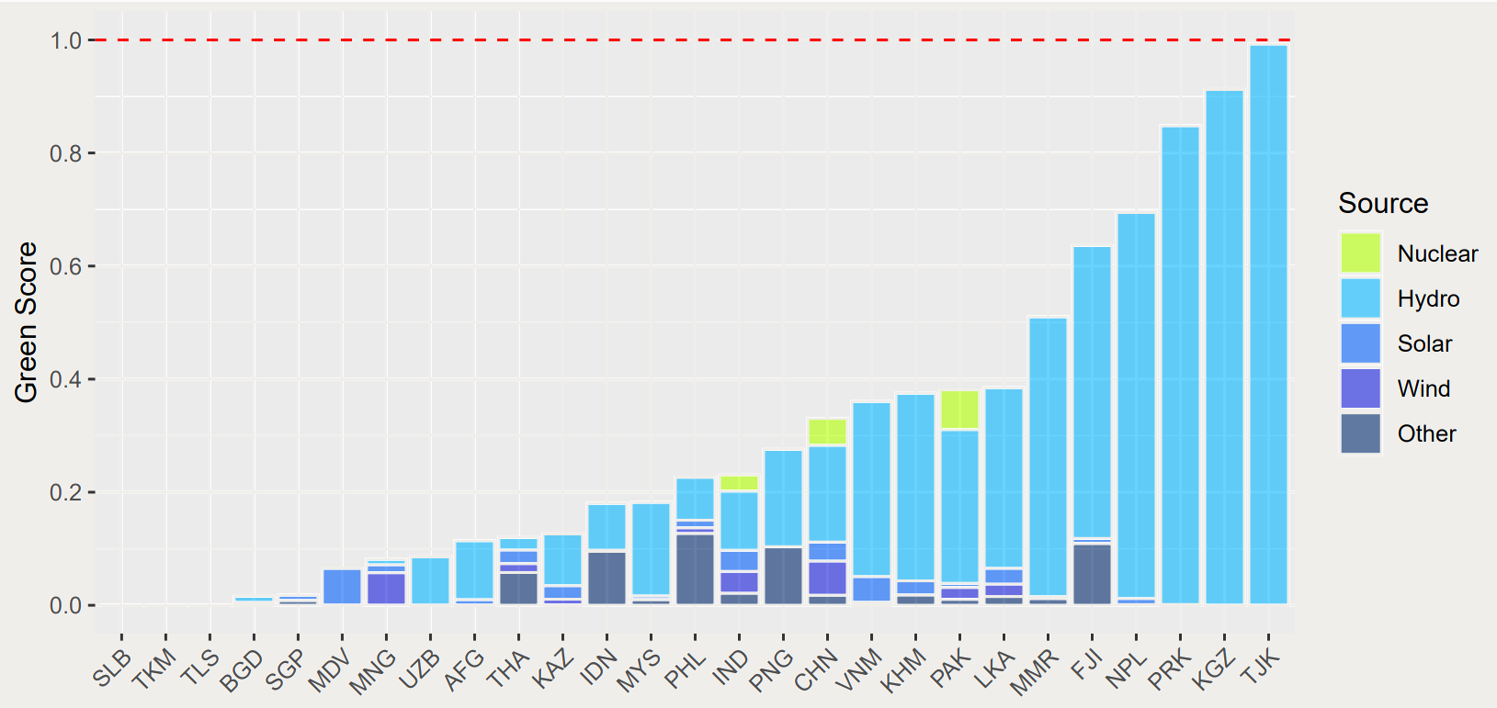
Latin-America, Asia and Sub-Saharan Africa: the hydropower rule

Slide 33
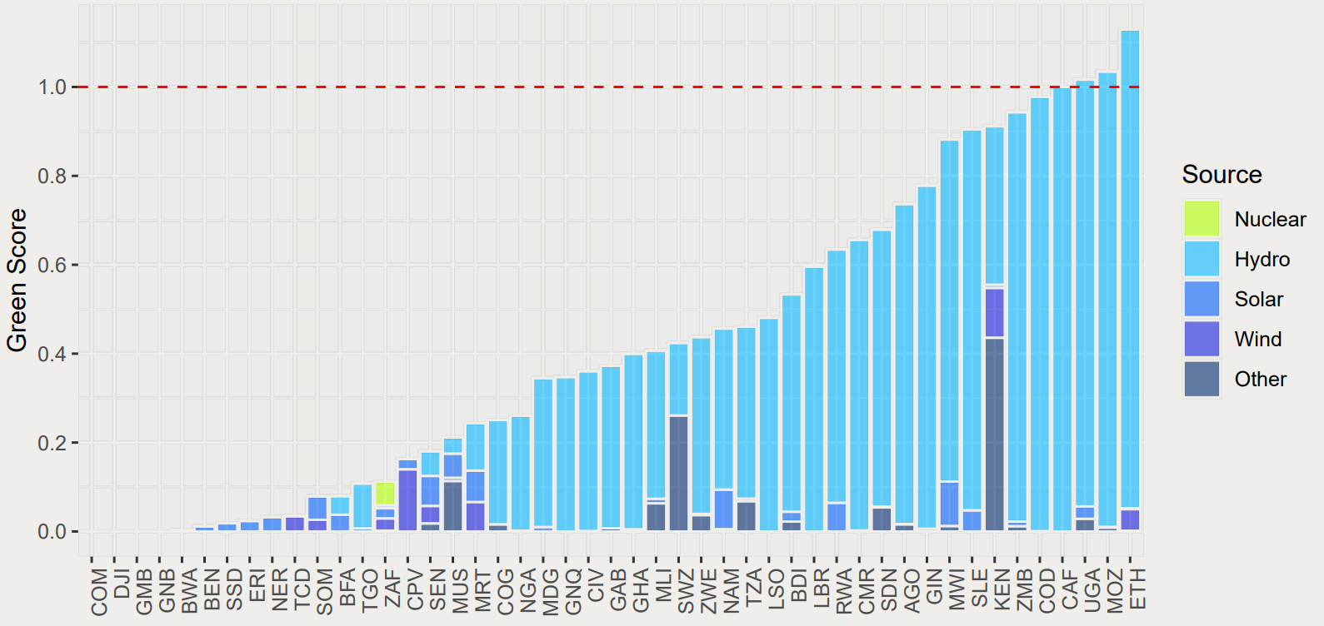
Latin-America, Asia and Sub-Saharan Africa: the hydropower rule

Slide 34
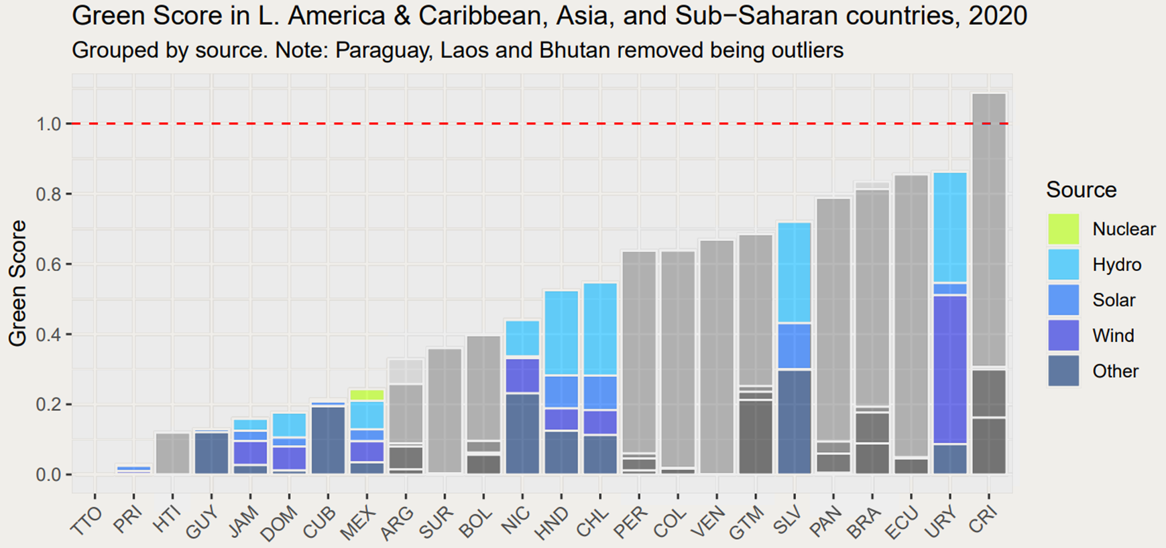
Uruguay: the wind republic

Slide 35
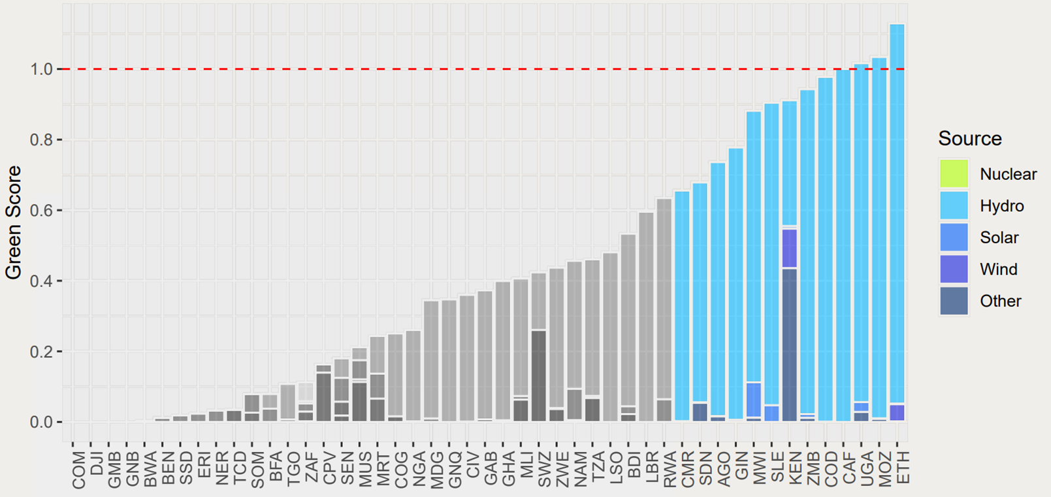
Kenya: a successful exploitation

Slide 36
Kenya: a successful exploitation
https://www.imf.org/en/Publications/fandd/issues/2022/12/country-case-kenya-taps-the-earth-heat

Slide 37
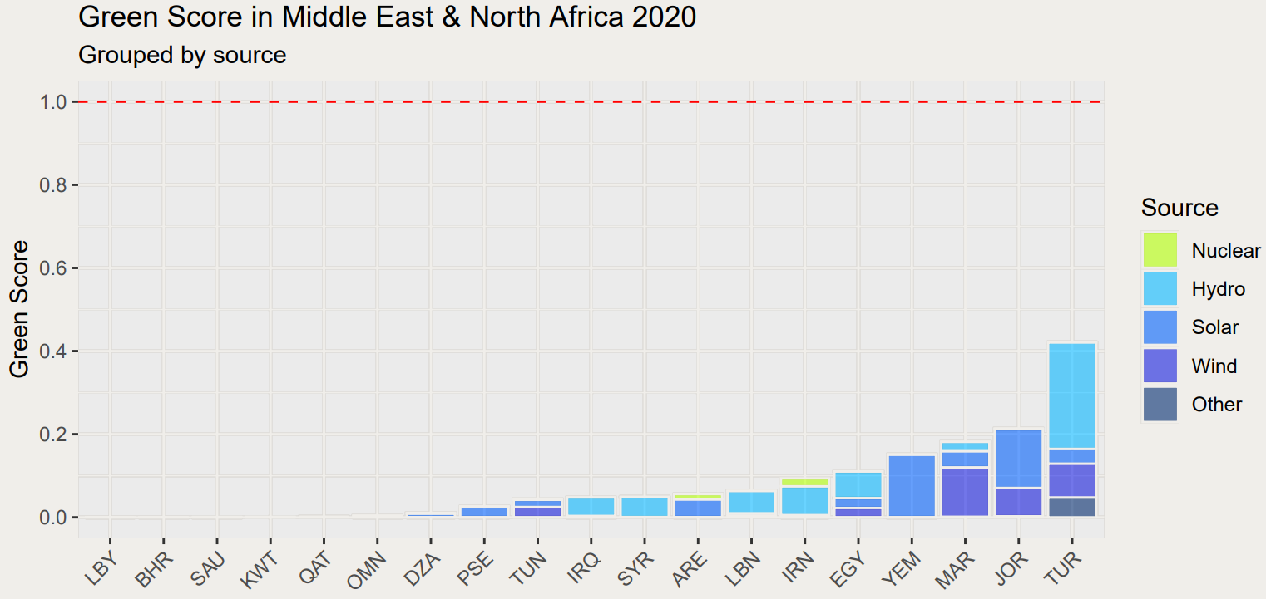
The Middle East and North Africa: the fossil fuel dependency

Slide 38
Per capita reserves of oil and gas
 | Oil (2020) | Gas (2020)
Middle East & North Africa | 469.81 tonnes | 583,180.3 m³
Other countries | 18.40 tonnes | 22,920.9 m³

